Slide 1
Implement and apply of canny edge detector and Hough transform
Presented by:
Sourav patel(20EC65R25)
DISHANT SATULEY(20EC65R03)

Slide 2
Motivation
Detection: The probability of detecting real edge points should be maximized while the
probability of falsely detecting non-edge points should be minimized. This corresponds to
maximizing the signal-to-noise ratio.
Localization: The detected edges should be as close as possible to the real edges.
Number of responses: One real edge should not result in more than one detected edge.
With JFC’s mathematical formulation of these criteria, Canny’s Edge Detector is optimal for
a certain class of edges (known as step edges).

Slide 3
Steps followed:
Step 1 - Grayscale Conversion
Step 2 - Gaussian Blur
Step 3 - Determine the Intensity Gradients
Step 4 - Non Maximum Suppression
Step 5 - Double Thresholding
Step 6 - Edge Tracking by Hysteresis
Step 7 - Cleaning Up

Slide 4
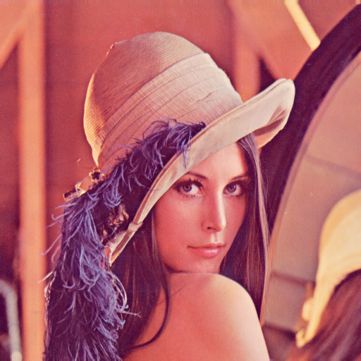

greyscale conversion:
Converted the image to grayscale.
Input image
Output image

Slide 5
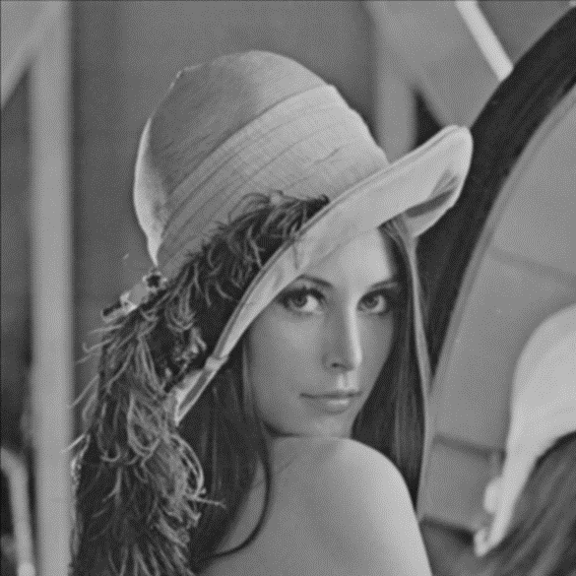
Gaussian blur:
It gives a smoothened image as output.
In image processing, a Gaussian blur (also known as Gaussian smoothing) is the result of blurring an image by a Gaussian function.

Slide 6
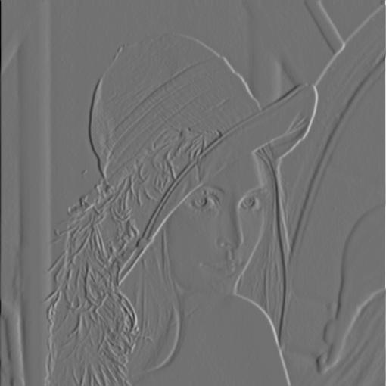
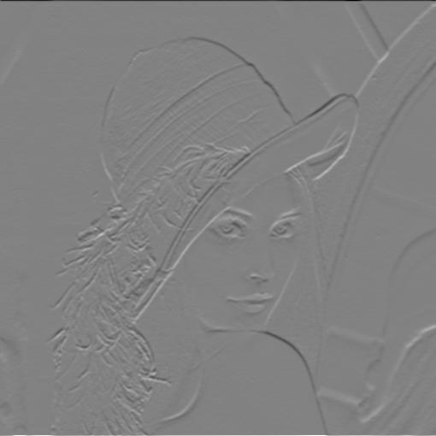
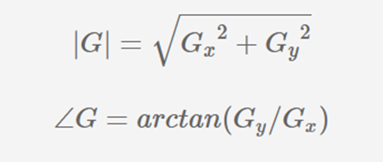
Determining the intensity gradient:
We preferred Sobel operator and it is the general approach to go with the Sobel operator for determining the gradient of the image.
The resultant gradient approximation can be calculated with
Image X
Image Y

Slide 7
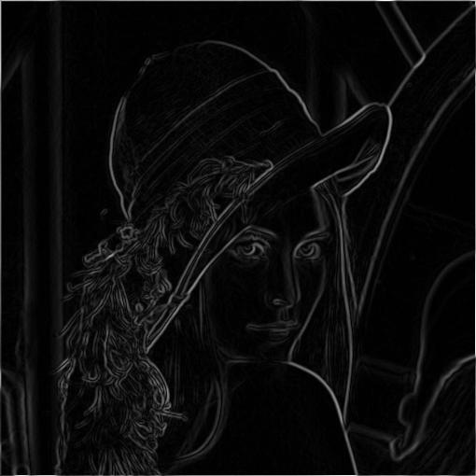
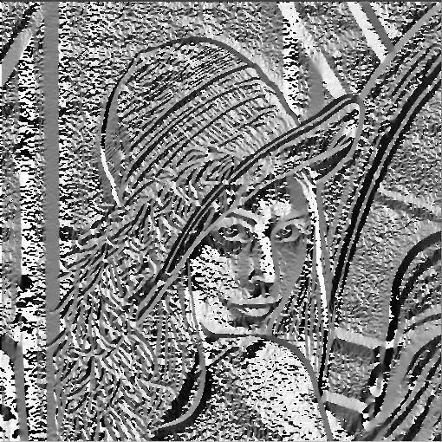
Determining the intensity gradient:
We preferred Sobel operator and it is the general approach to go with the Sobel operator for determining the gradient of the image.
The resultant gradient approximation can be calculated with
Magnitude Image
Angle Image

Slide 8
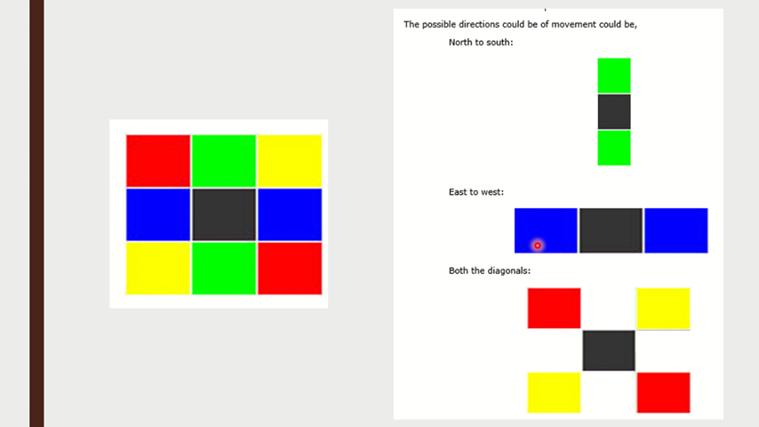
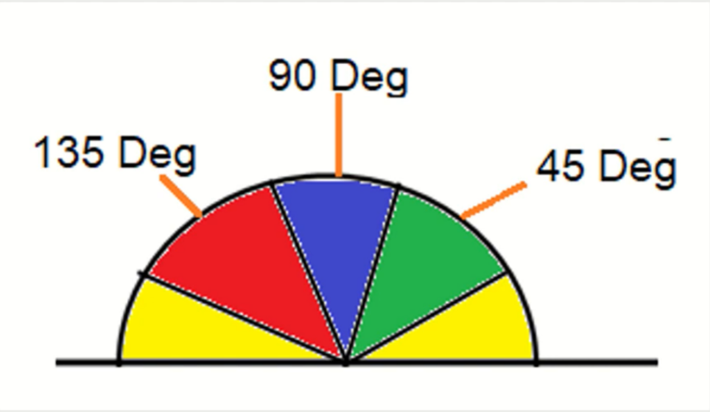
Non-maximum suppression:
We have already got the angle and now we want the DIRECTION. So for that we have divided the DIRECTION into 4 category. For different angle, different range is available and respective DIRECTION is determined.
It can be either right-left, top-down, right diagonal or left diagonal.
For the classification, we have given below the example with some illustration.

Slide 9
1. Any edge which comes under the yellow range is set to 0 degrees(which means from 0 to 22.5 degree 57.5 degrees are set to 0 degrees)
2. Any as which come under the green range is all set to 45 degrees.(which means 22.5 degrees to 67.5 is 45 degrees)
3. Any age coming under the blue range is all set to 90 degrees.(which means 67.5 to 112.5 degrees is set as 90 degrees)
4. The last remains easy-to-understand any age coming under the red range is all set to 135 degrees(which means 112.5 to 157.5 degrees is set as 135 degrees)

Slide 10
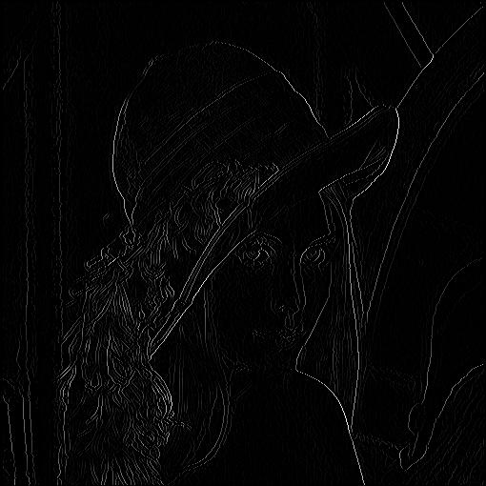
• Non maximum suppression as the name suggests, is a process for separation of the pixels 2019 not be considered as an edge is carried out. This will enable the system to generate a thin line in the output image as shown below.
Output After Non-Maximum Suppression

Slide 11
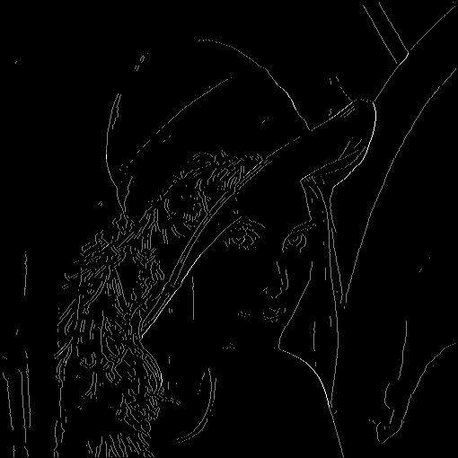
Double Thresholding:
Simple assume high threshold value as 0.7. Any pixel with Value above 0.7 is to be seen as strong edge.
Another threshold the lower one can be 0.3. In that case any pixel below this value is not an edge at all and hence set them all to 0.
And all the values in between they may or may not be an edge. They are referred as a weak edge. There has to be a process to determine which of the weak edges are actual edges so as to not to miss them.

Slide 12
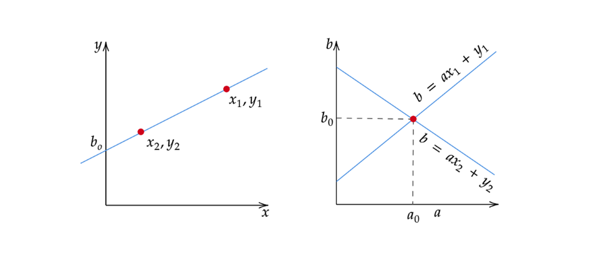
The hough transform:
The Hough Space is a 2D plane that has a horizontal axis representing the slope and the vertical axis representing the intercept of a line on the edge image. A line on an edge image is represented in the form of y = ax + b (Hough, 1962).
One line on the edge image produces a point on the Hough Space since a line is characterized by its slope a and intercept b. On the other hand, an edge point (xᵢ, yᵢ) on the edge image can have an infinite number of lines pass through it.
Therefore, an edge point produces a line in the Hough Space in the form of b = axᵢ + yᵢ (Leavers, 1992). In the Hough Transform algorithm, the Hough Space is used to determine whether a line exists in the edge image.

Slide 13
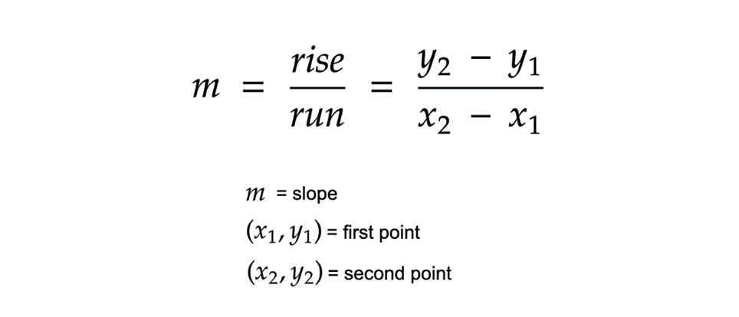
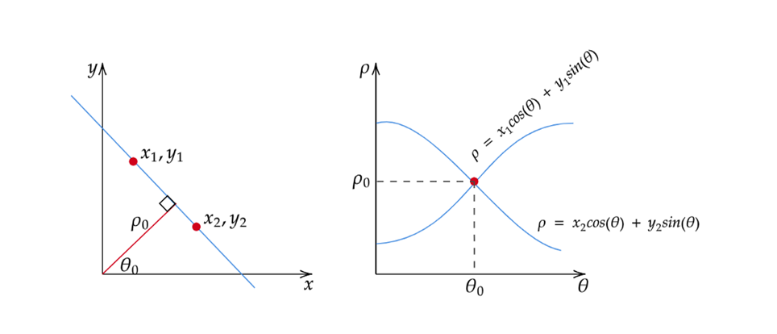
An alternative way:
There is one flaw with representing lines in the form of y = ax + b and the Hough Space with the slope and intercept. In this form, the algorithm won’t be able to detect vertical lines because the slope a is undefined/infinity for vertical lines.
Programmatically, this means that a computer would need an infinite amount of memory to represent all possible values of a.
To avoid this issue, we will represent the line in a different way. The form of the normal line is ρ = x cos(θ) + y sin(θ) where ρ is the length of the normal line and θ is the angle between the normal line and the x axis.

Slide 14
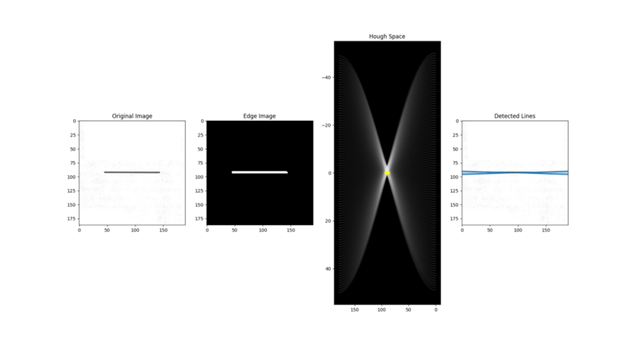
Line Detection:
the Hough Transform algorithm detects lines by finding the (ρ, θ) pairs that has a number of intersections larger than a certain threshold

Slide 15
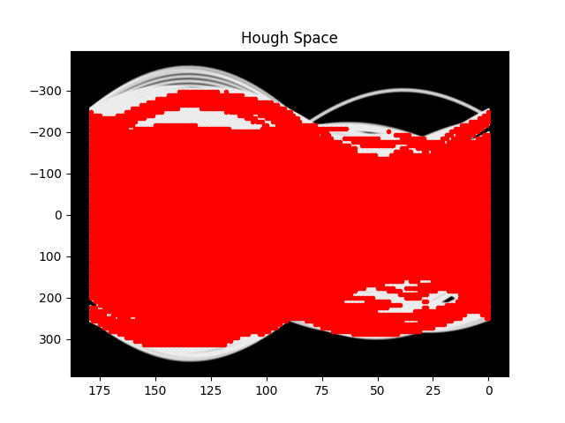
Upon converting the edge image into Hough space, we are getting below output.

Slide 16
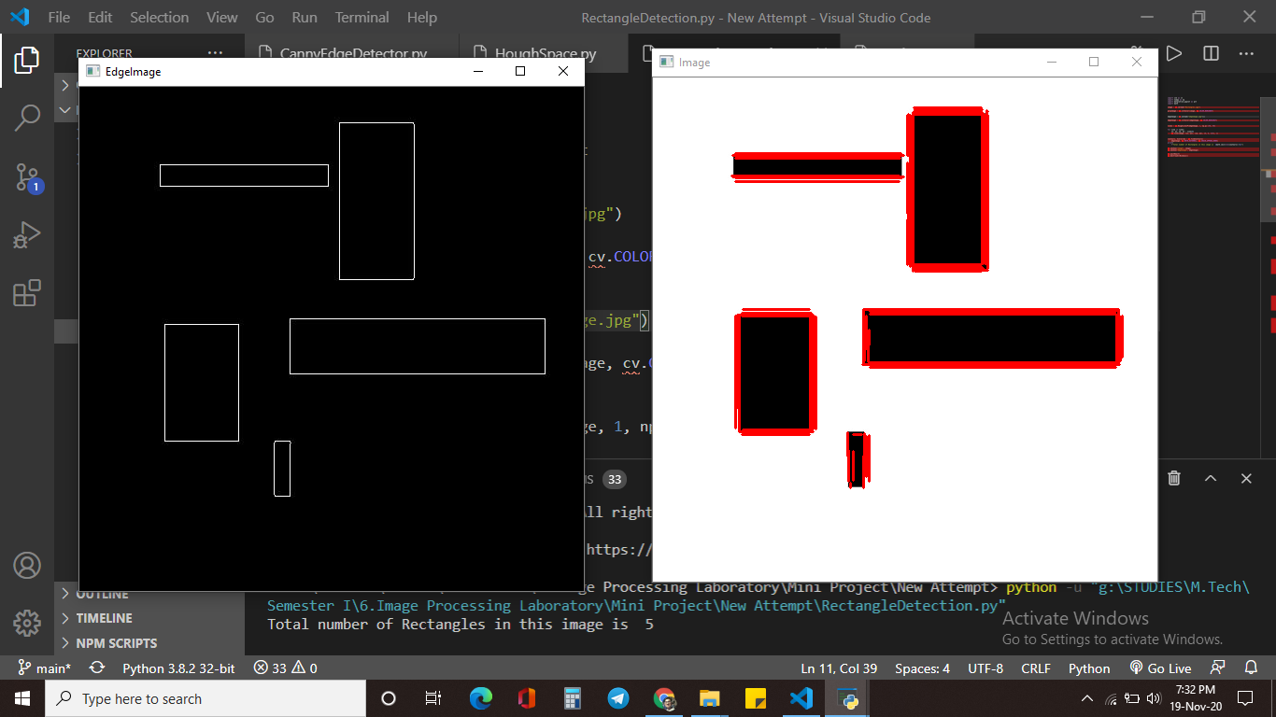
We wrote a python program that detects the number of rectangles in the image and then we have detected the number of rectangles.

Slide 17
CONCLUSION:
We have implemented Canny edge detection technique from the scratch and later implemented that on our next task, which was finding the number of rectangles on an image by detecting the lines by Hough transform. It was done with the help of the algorithm used in the Canny’s edge detection technique.

